Slide 1
🚨 Fraud Detection System

Slide 2
Agenda
Dataset & Preprocessing
Model & Training
Evaluation
GUI Demo
Conclusion
introduction

Slide 3
introduction
Problem: Explain the growing risk of financial fraud in online transactions.
Goal: Build an AI model to detect fraudulent transactions in real time.
Impact: Reduce financial loss and protect users.

Slide 4
Work Flow
Idea & dataset Gathering
Data Preprocessing
Feature Selection
Data Splitting
Feature Scaling
Machine Learning Models
Evaluation Metrics
GUI & presentation Creation

Slide 5
2. Dataset & Preprocessing
Source: https://www.kaggle.com/datasets/ranjitmandal/fraud-detection-dataset-csv.
Features: transaction amount, location, device used, etc.
Preprocessing:
Handle missing values.
Encode categorical data.
Normalize or scale numerical values if needed.

Slide 6
3. Model & Training
Model Used: Random Forest Classifier
Why?
Good for classification
Handles different types of data
Works well even if the data is imbalanced
Training Steps:
Split data into training and testing
Train the model on training data
Save the model using joblib.

Slide 7
5. GUI (User Interface)
Purpose: Lets the user enter transaction details and check if it's fraud or not.
How it Works:
User fills in form fields (amount, location, device, etc.)
Clicks "Predict"
The model gives a result: Fraudulent or Not Fraudulent
Tools Used: Streamlet.

Slide 8
GUI – Fraud Detection App
Purpose: A simple app that lets users test transactions and get instant fraud predictions.
How it works:
User fills in the form.
Clicks Predict.
Model returns a result: Fraudulent / Not Fraudulent.

Slide 9
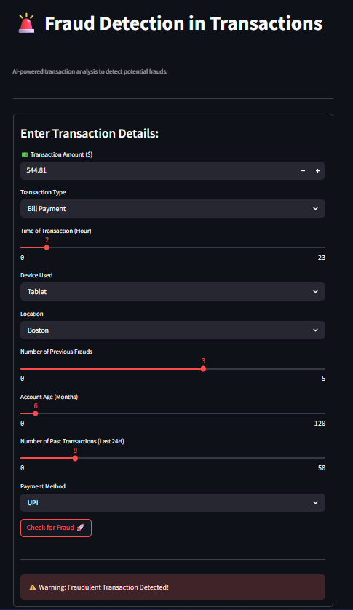
Incase of detecting a fraud

Slide 10
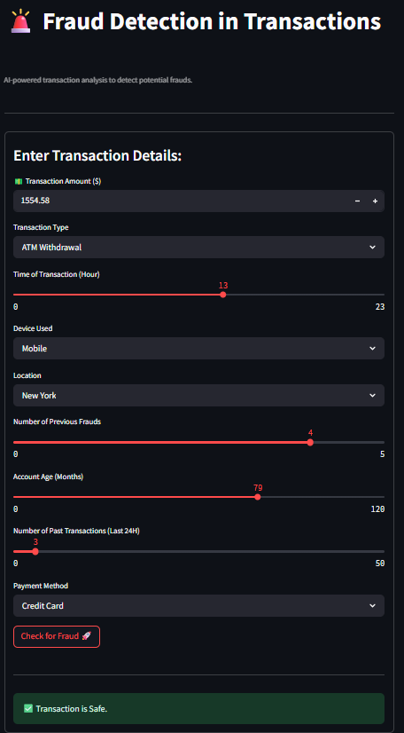
Incase of safety.

Slide 11
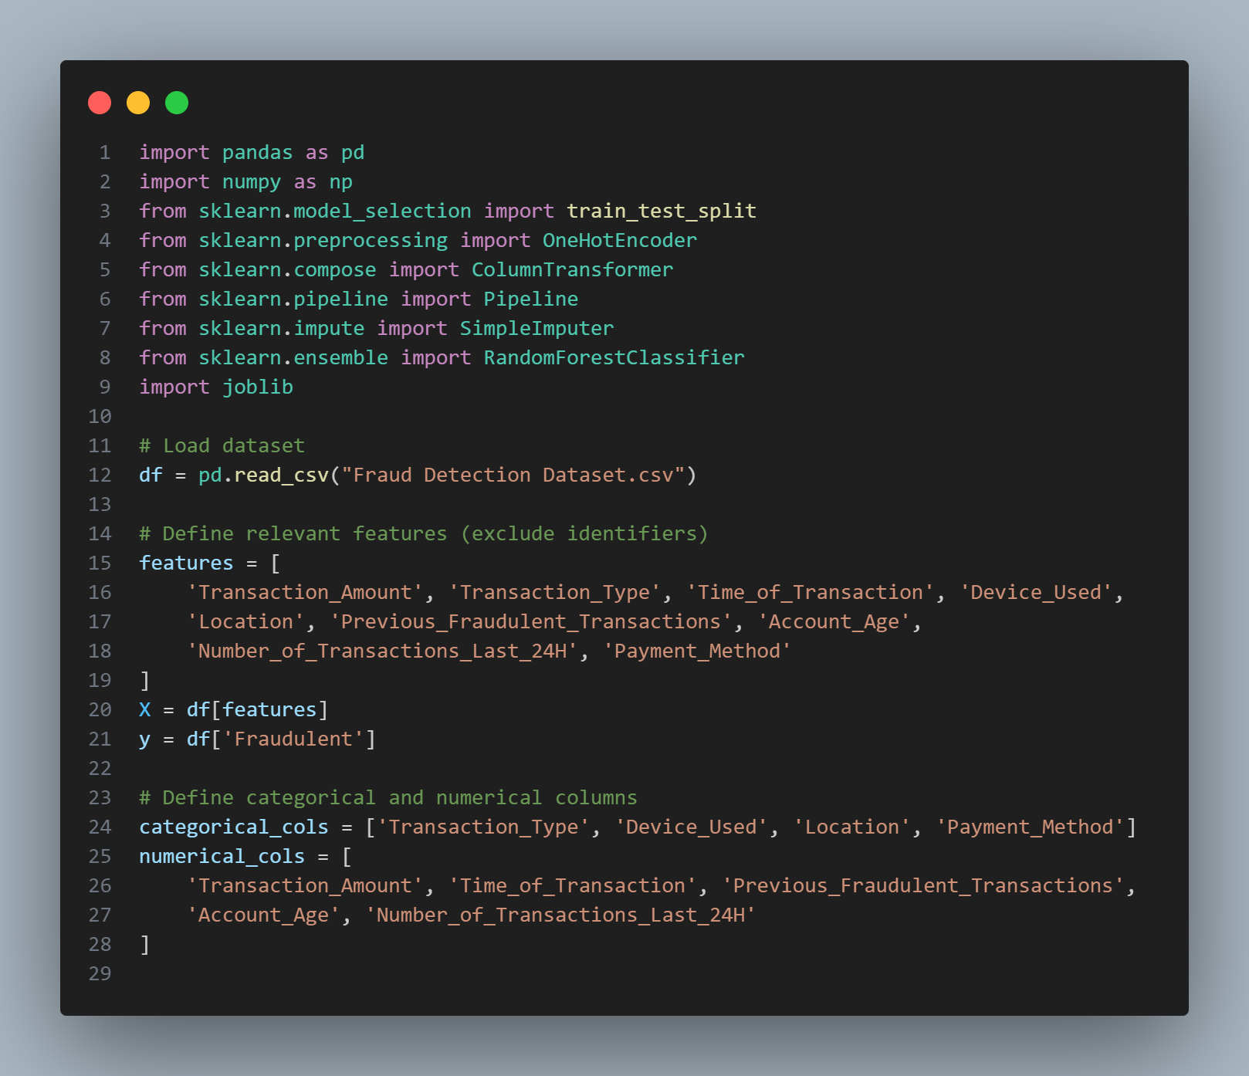
The code

Slide 12
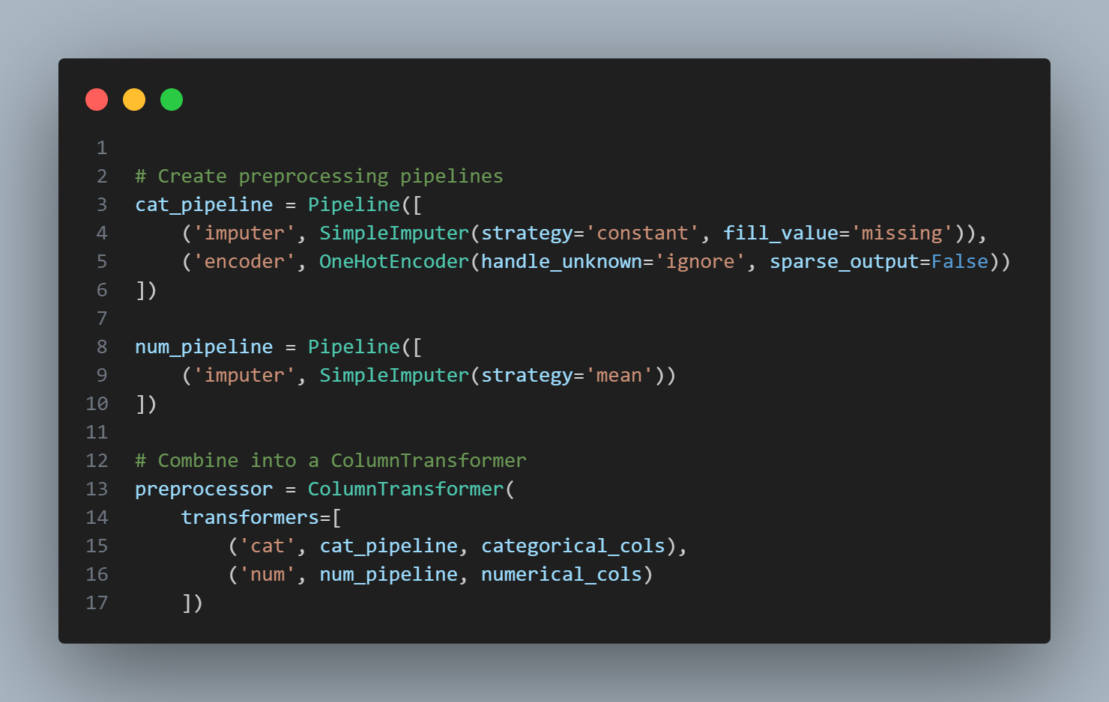
The code

Slide 13
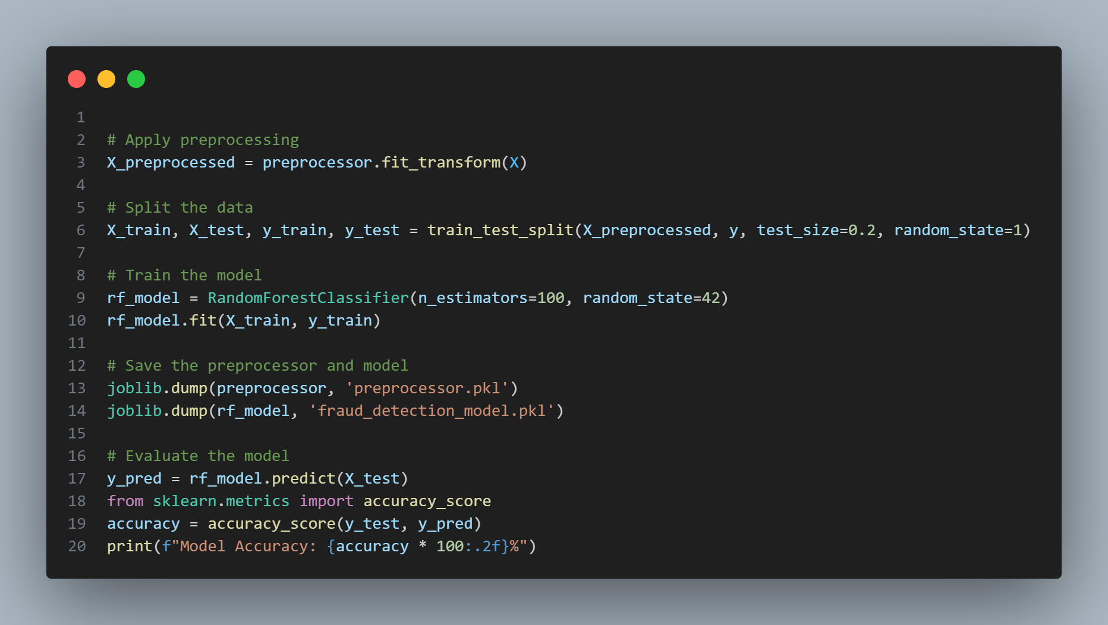
The code

Slide 14
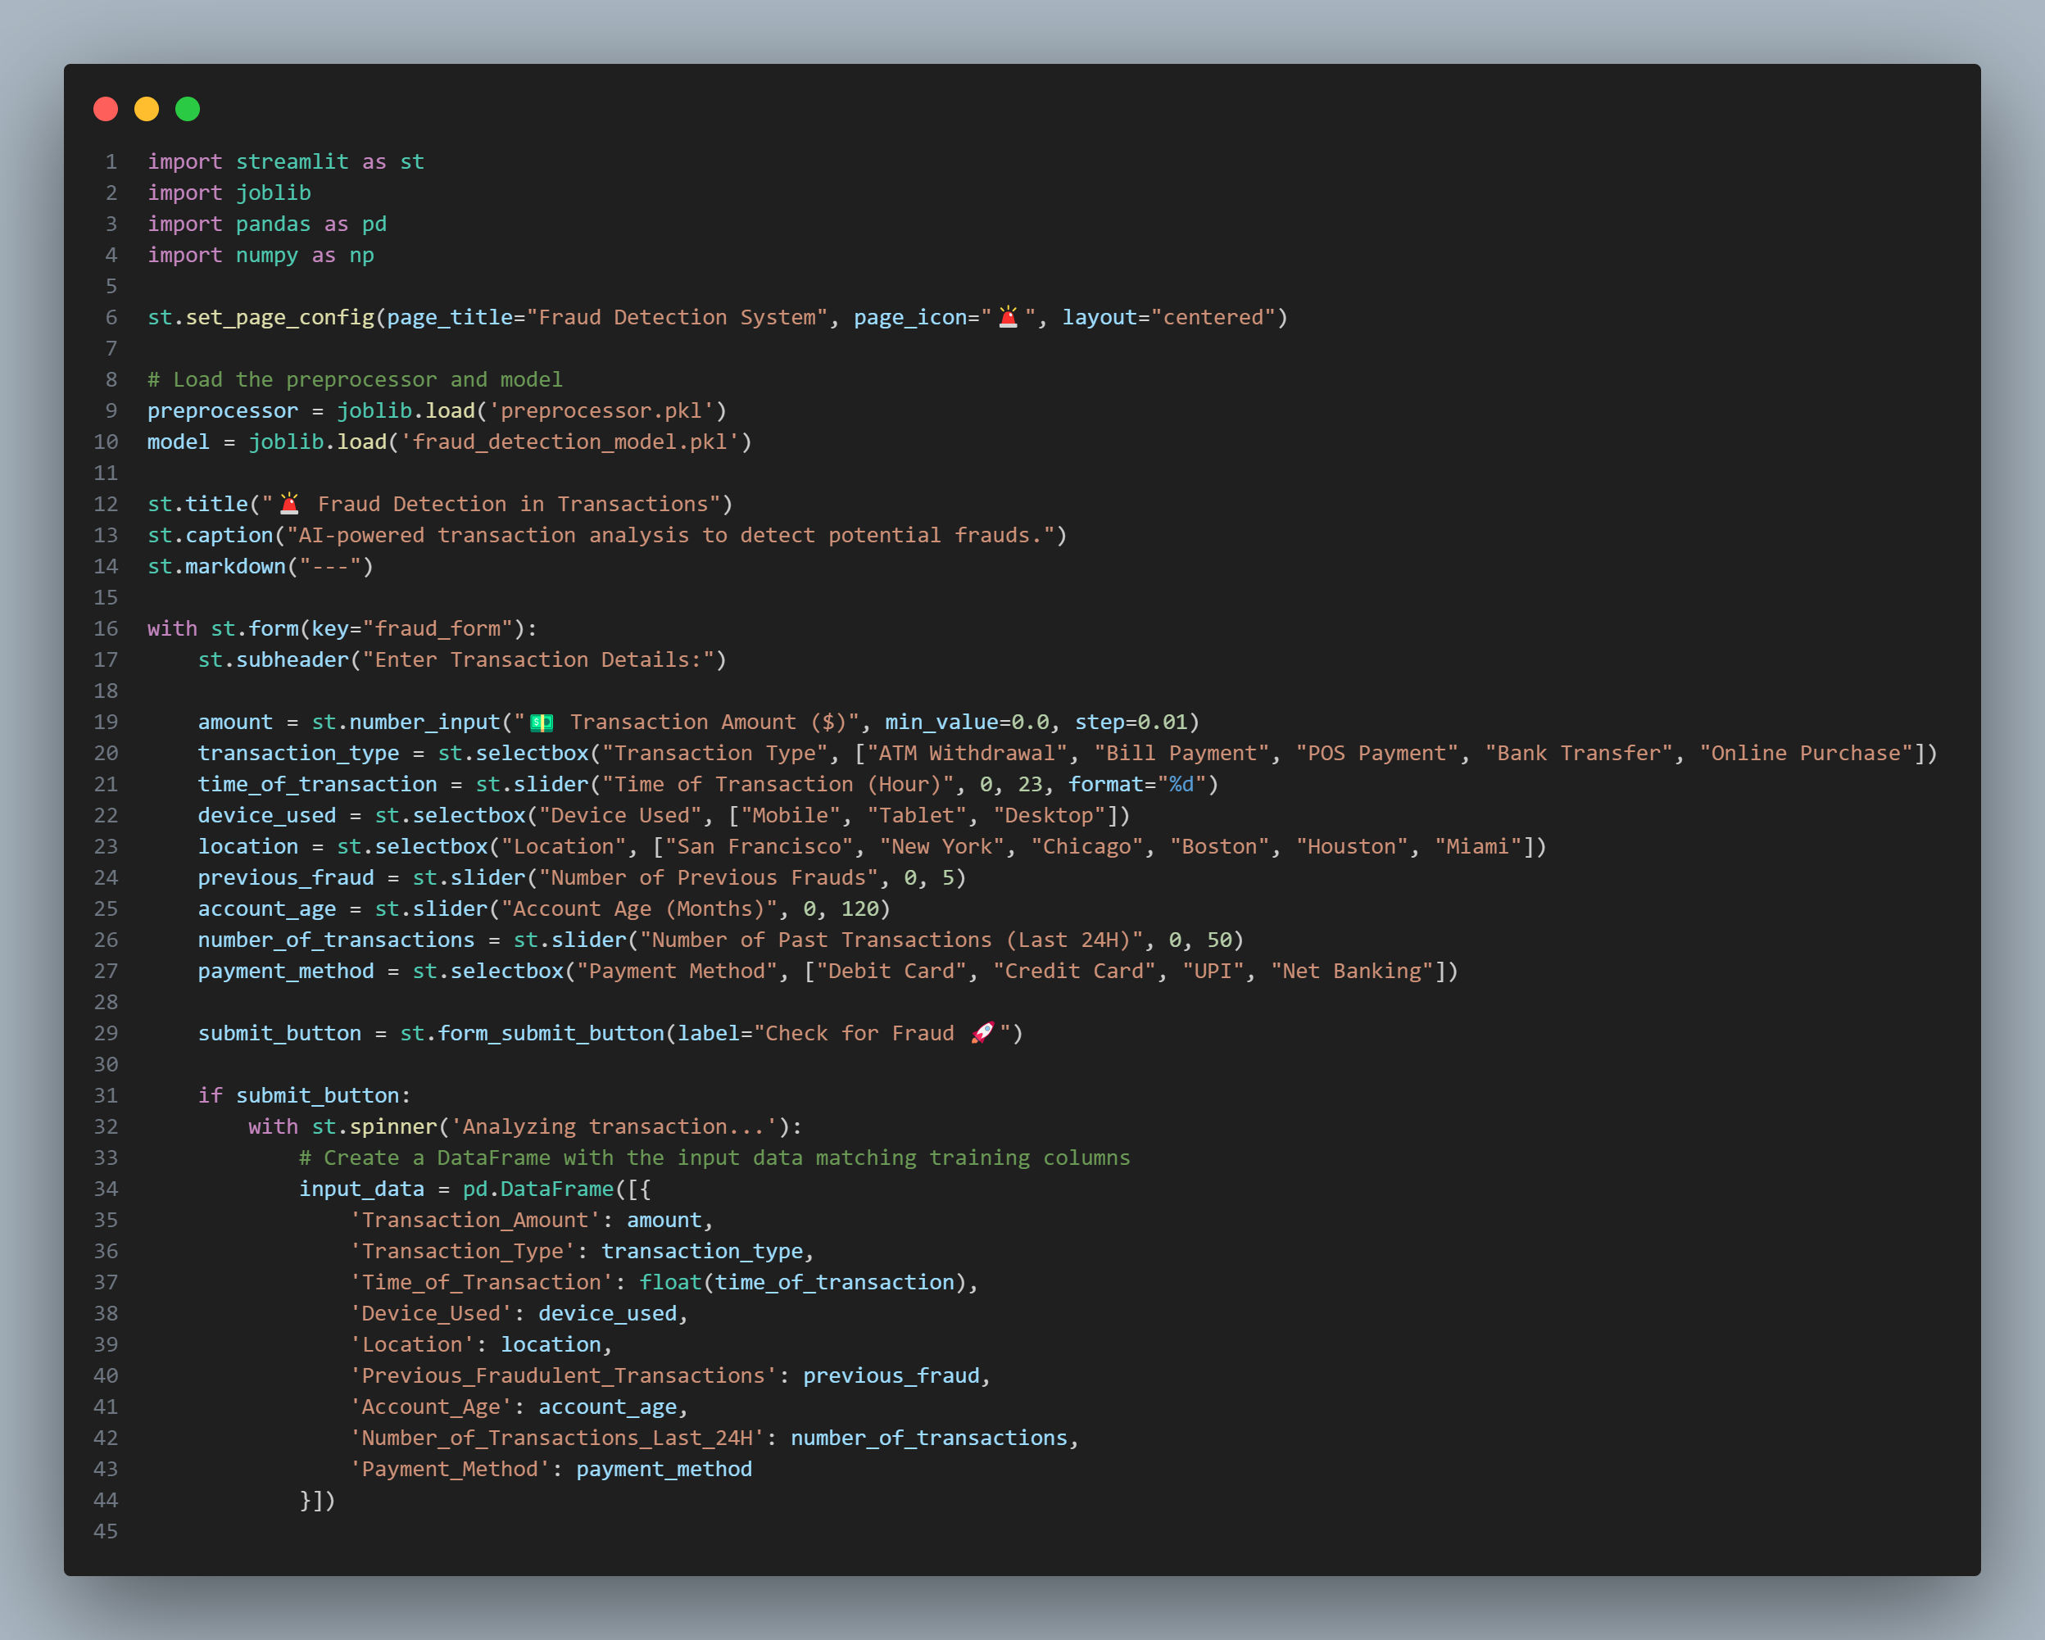
The code

Slide 15
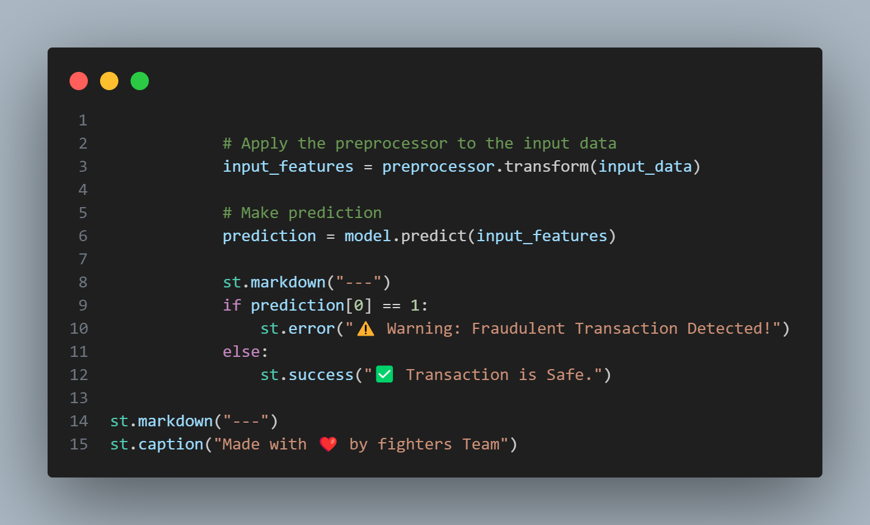
The code

Slide 16
THANK YOU

